Slide 1

PROPERTIES OF THE DARKWEB
Tombini Nicolò - 10912627

Slide 2
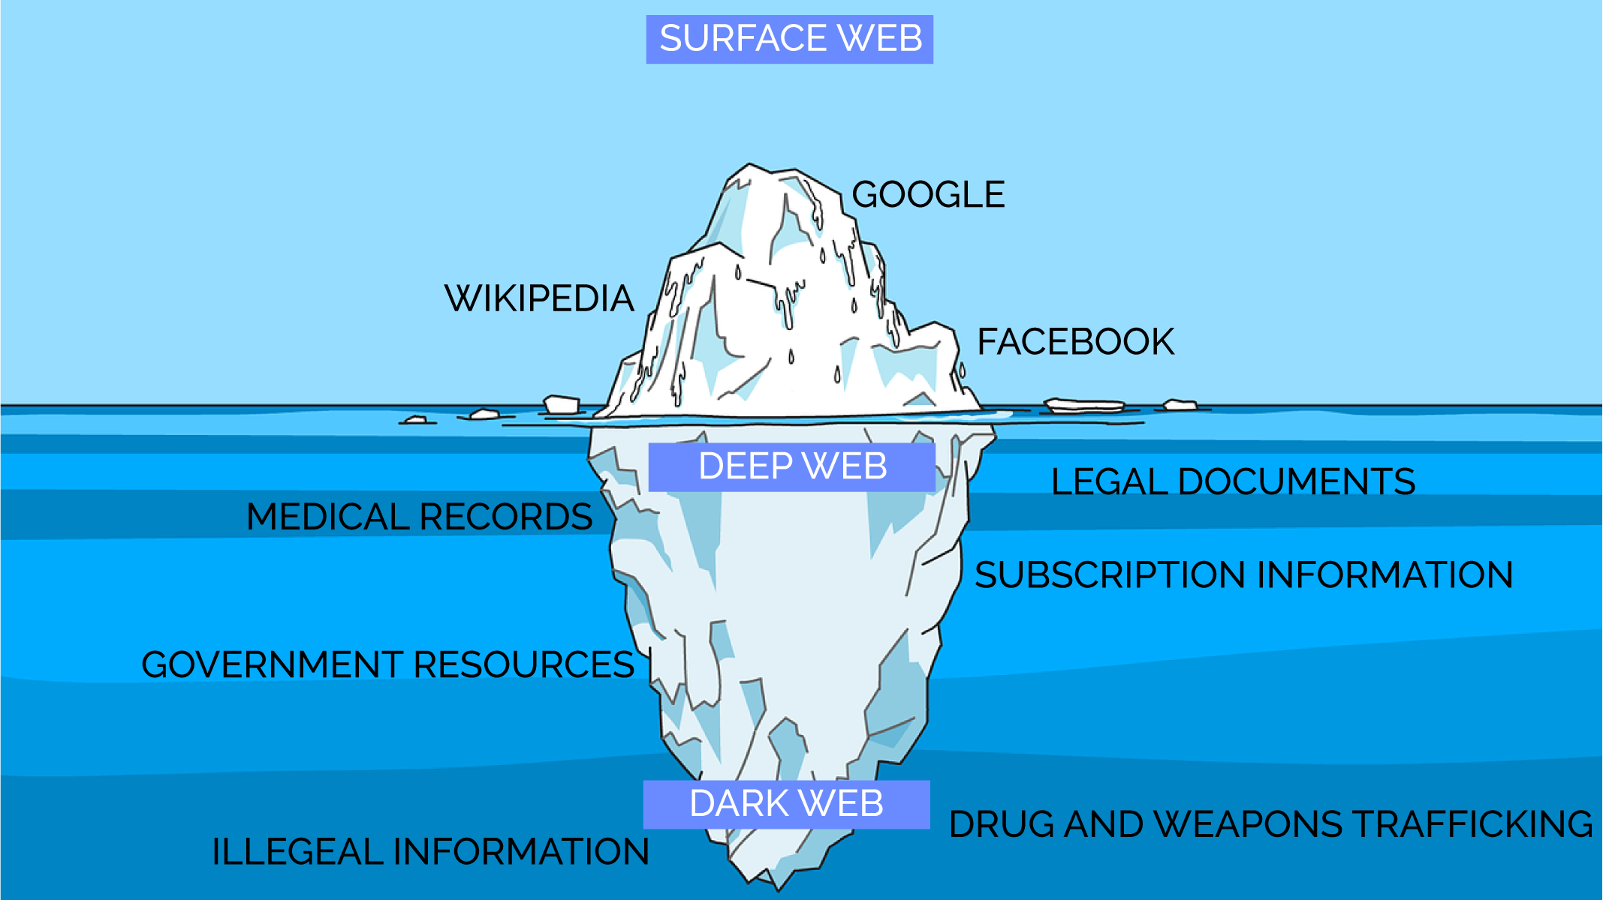
What is darkweb?

Slide 3




What is darkweb?
146.241.45.158
hwikis25cffertqe

Slide 4




TABLE OF CONTENTS
O
C
M
R
VERVIEW
ENTRALITIES
ESEOSCALE
OBUSTNESS
Network overview and its major properties
Network analysis based on centralities
Mesoscale network analysis: community detection, core-periphery
Link prediction and tolerance to random failures and attacks

Slide 5
—Wikipedia
“The dark web is the World Wide Web content that exists on darknets: overlay networks that use the Internet but require specific software, configurations, or authorization to access.”

Slide 6
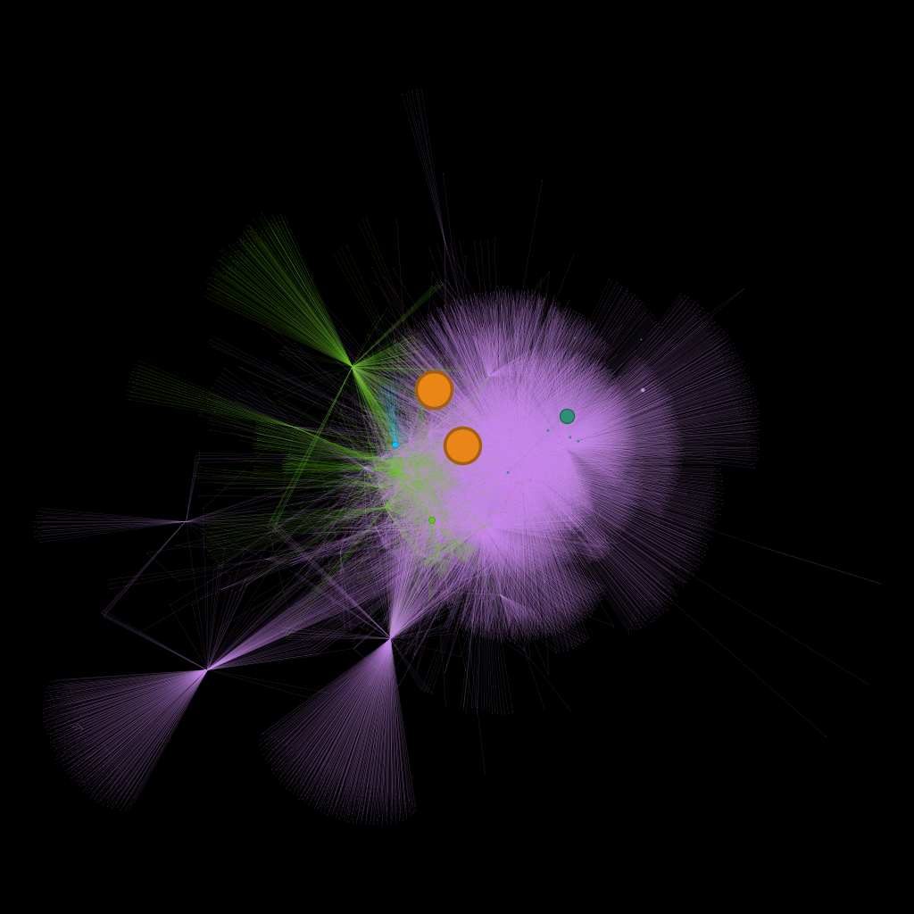
01
OVERVIEW
Network overview and its major properties

Slide 7
GENERAL CHARACTERISTICS
PROPERTY | VALUE
Nodes | 7178
Edges | 25104
Network Type | Directed, weighted
N° isolated nodes | 0
N° self loops | 0
N° WCC | 1
Largest WCC | 7178
N° SCC | 6820
Largest SCC | 297

Slide 8
NETWORK PROPERTIES
PROPERTY | VALUE
Average Distance | 4.35
Diameter | 10.0
Global Clustering Coefficient | 0.51
Average degree | 3.5
Average strength | 505.67
Efficiency | 0.011
Density | 0.00049
Assortativity coefficient | 0.087

Slide 9
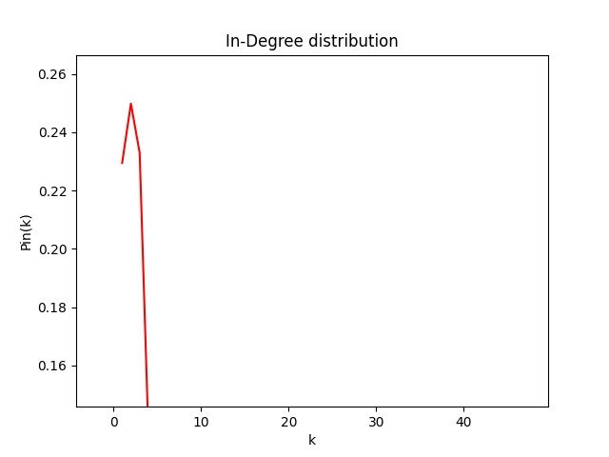
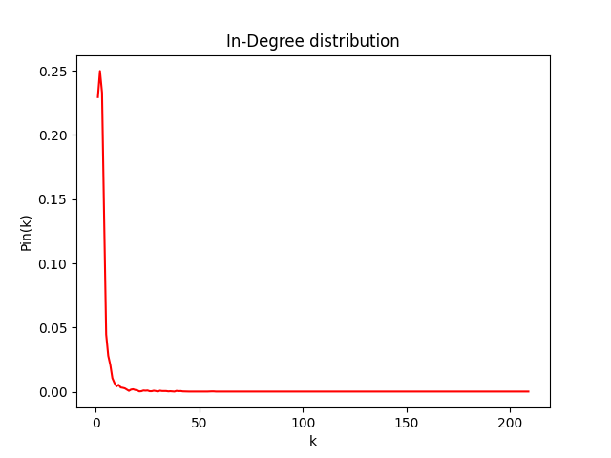
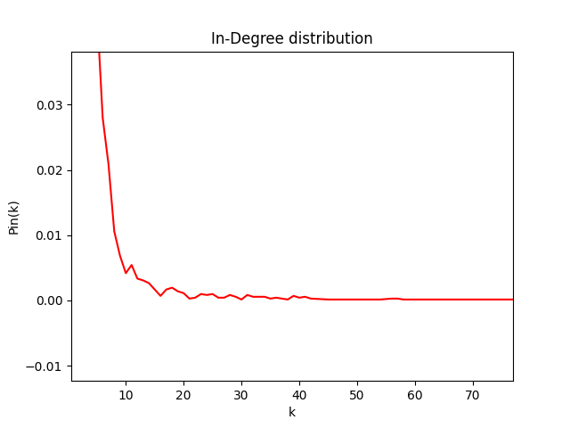
In-Degree Distribution

Slide 10
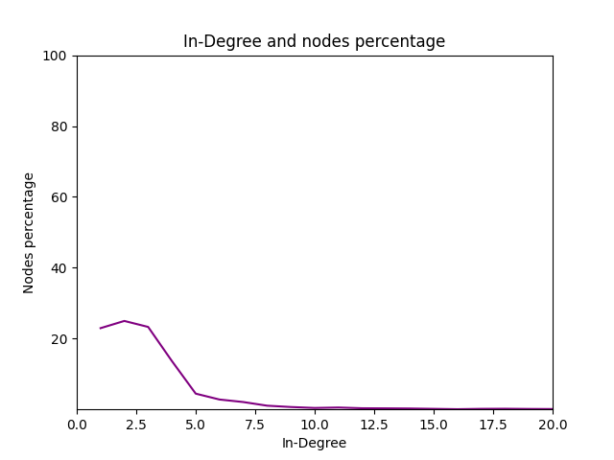
In-Degree nodes percentage
~30% of nodes (domains) have exactly one incoming link
Percentage of nodes with one incoming edge from out degree hubs = 78.2%

Slide 11
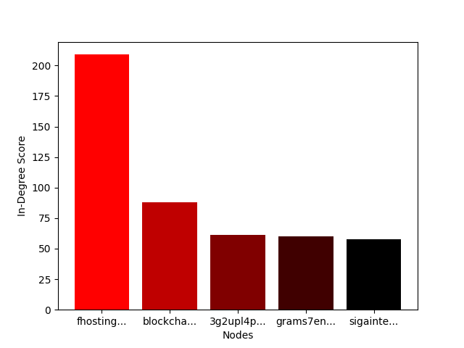
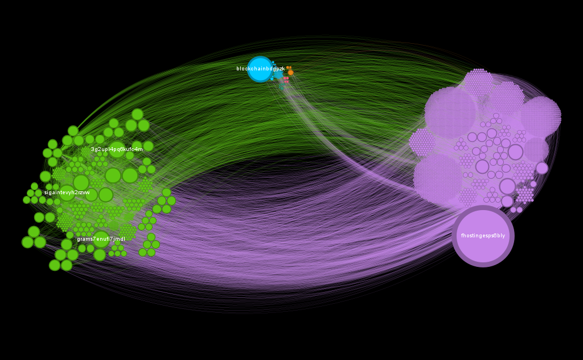
In-Degree Distribution on network
fhostingesps6bly (defunct): Formerly the largest Tor-specific web host, until the arrest of its owner in August 2013
blockchainbdgpzk: A popular bitcoin blockchain explorer service

Slide 12
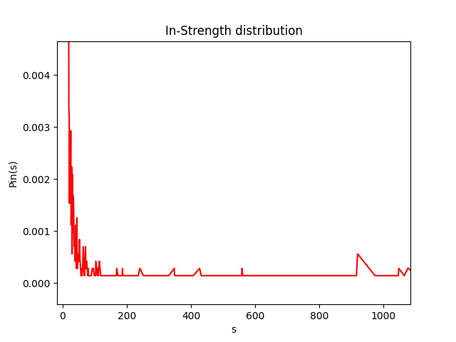
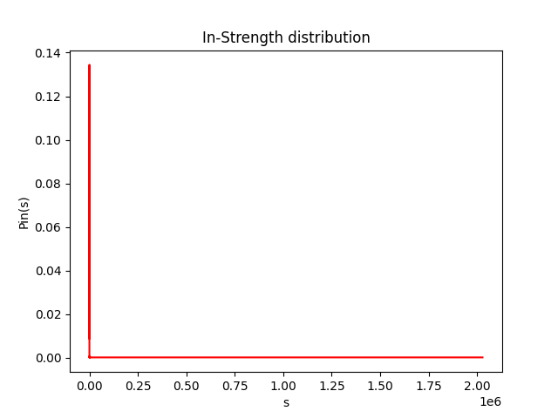
In-Strength Distribution

Slide 13
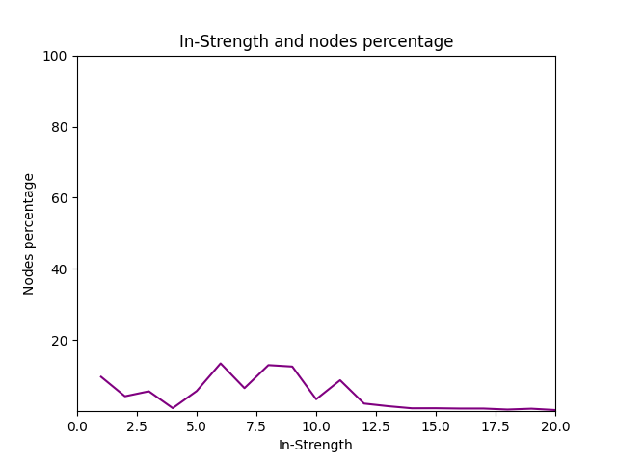
In-Strength nodes percentage
~10% of nodes (domains) have exactly in-strength equals to 1
~42% of nodes (domains) having in-degree equal to 1

Slide 14
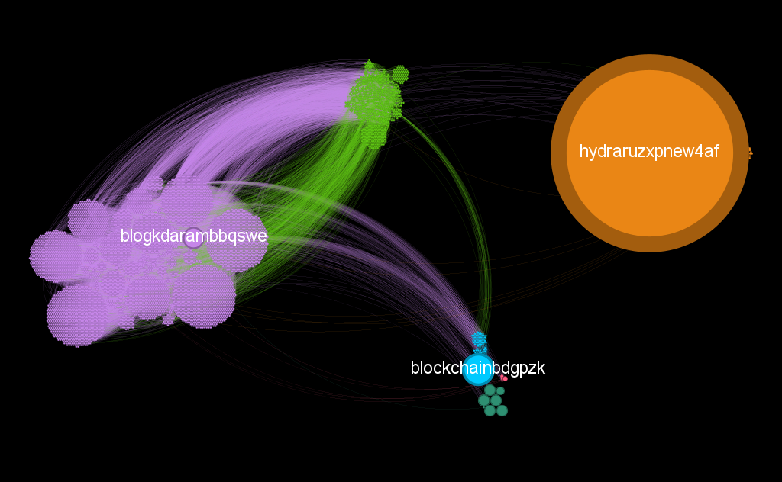
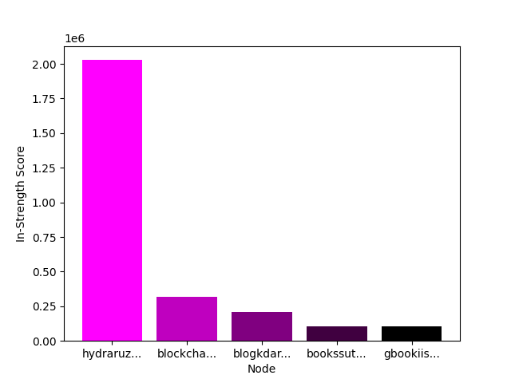
In-Strength Distribution on network
hydraruzxpnew4af: Darknet drug marketplace
blockchainbdgpzk: A popular bitcoin blockchain explorer service

Slide 15
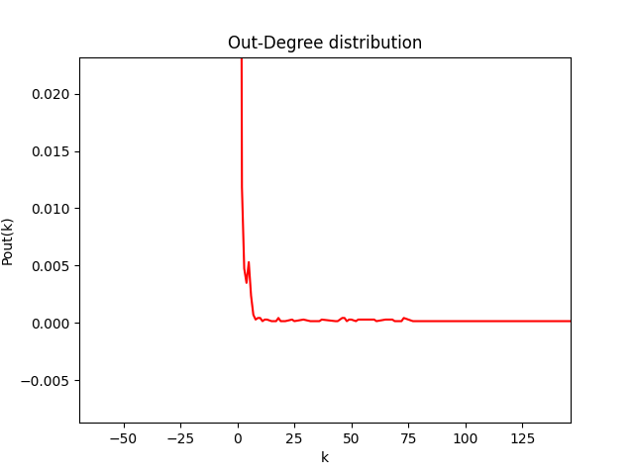
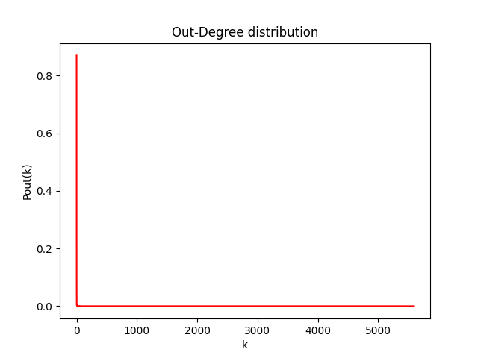
Out-Degree Distribution

Slide 16
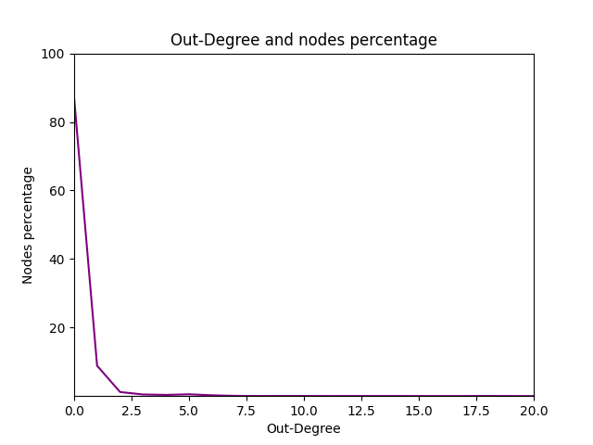
Out-Degree Distribution
~87% of nodes (domains) do not link to any other site

Slide 17
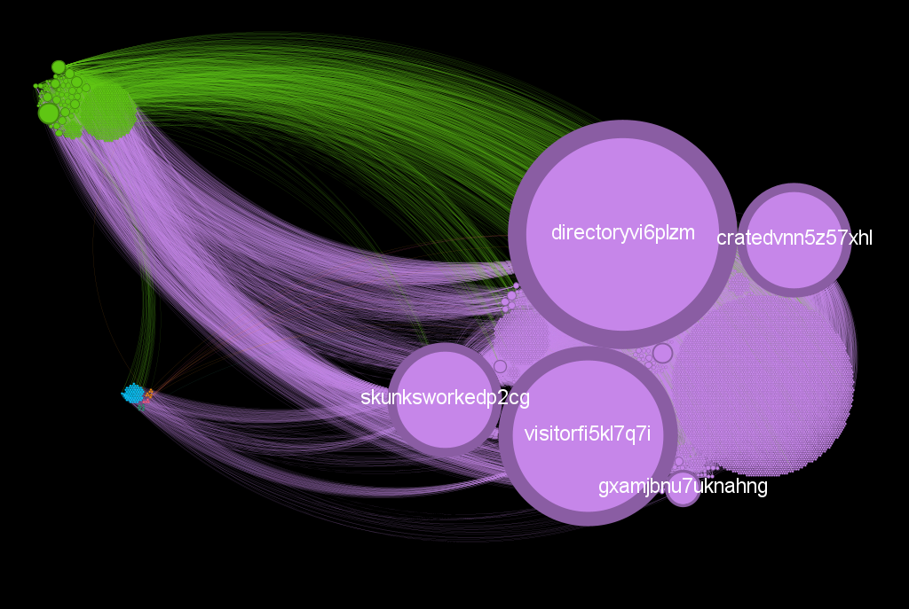
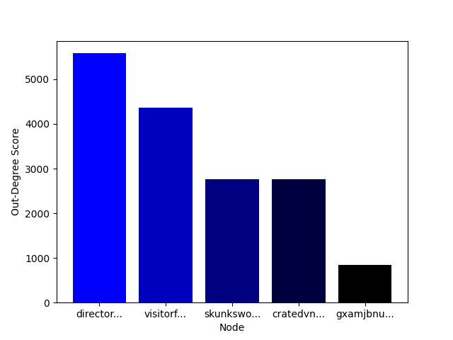
Out-Degree Distribution on network
directoryvi6plzm: Tor Directory: a list of onion
visitorfi5kl7q7i: VisiTOR Search Engine – Tor Hi

Slide 18
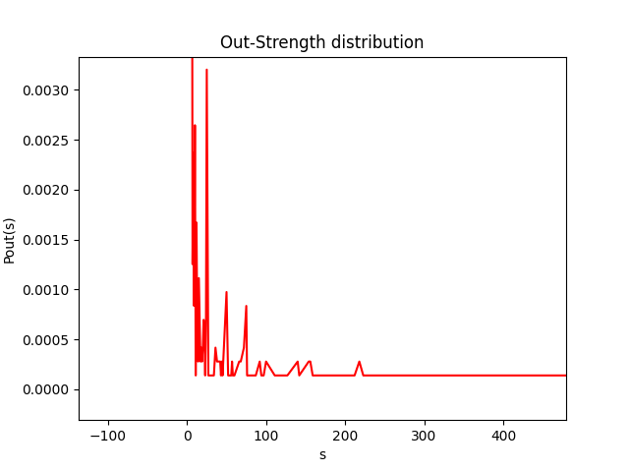
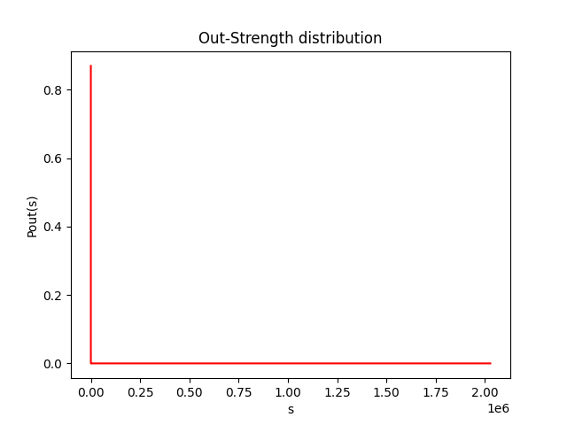
Out-Strength Distribution

Slide 19
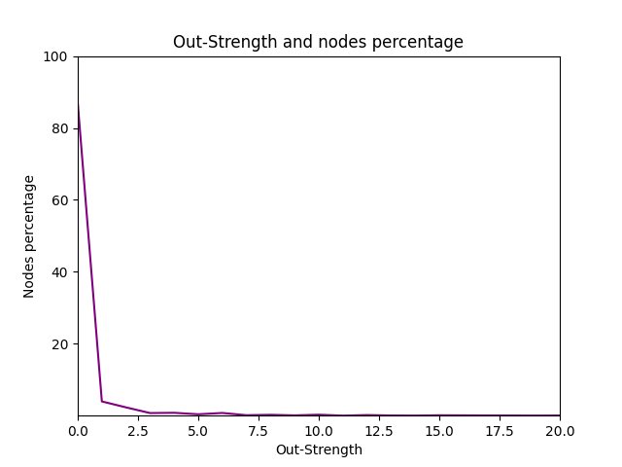
Out-Strength Distribution
~87% of nodes (domains) obviously have 0 out-strength because ~87% have 0 out-degree

Slide 20
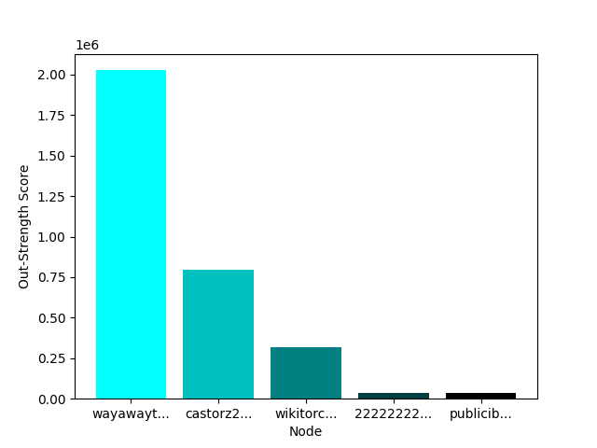
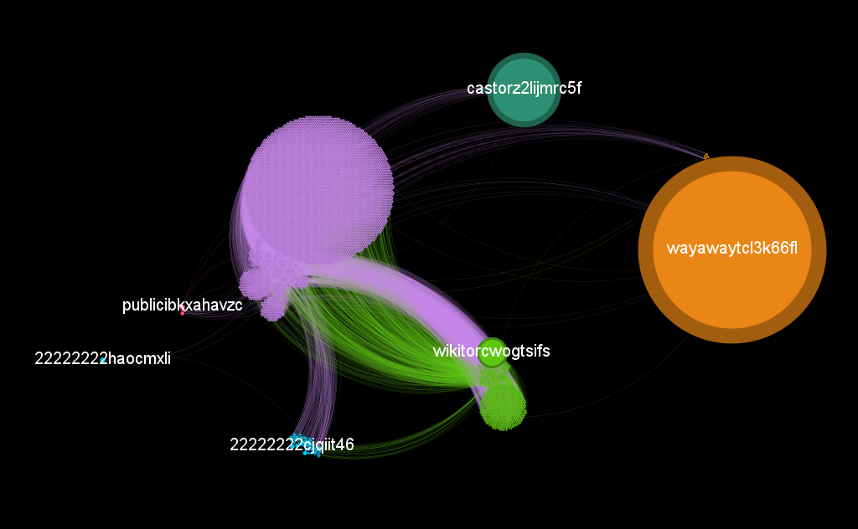
Out-Strength Distribution on network
wayawaytcl3k66fl: Russian drug forum
castorz2lijmrc5f: Big books library

Slide 21
02
NETWORK CENTRALITIES

Slide 22
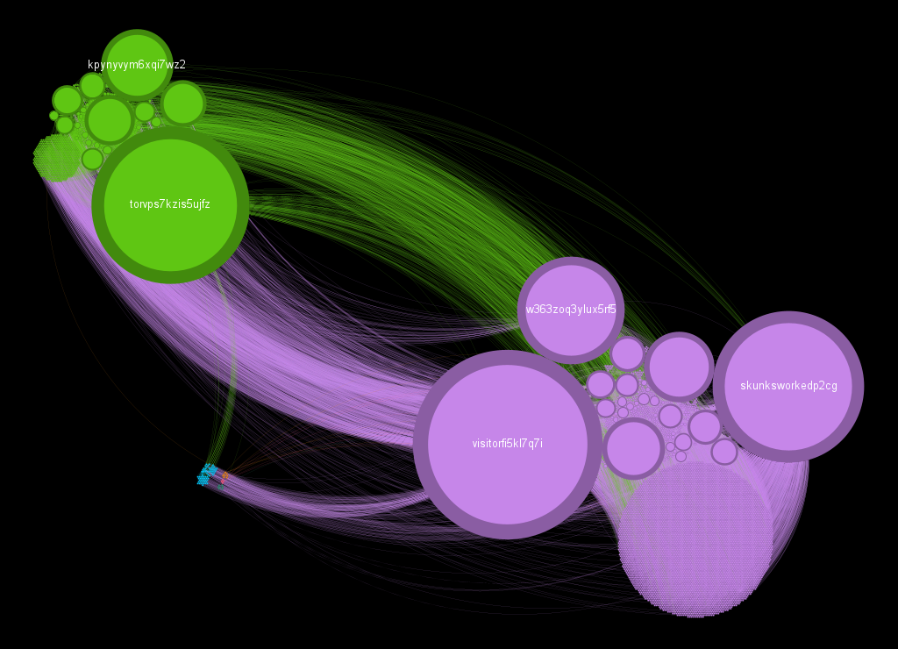
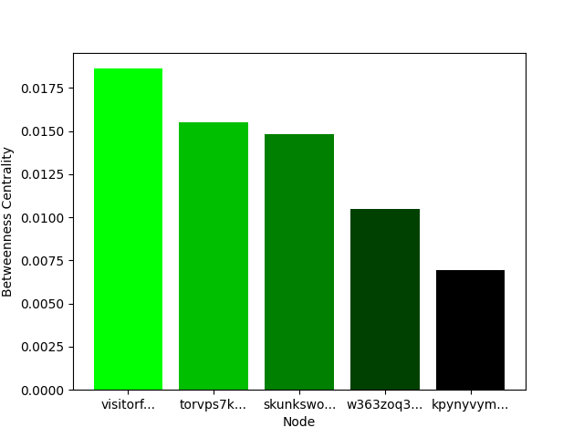
Betweenness Centrality
Put Your Screenshot
Here
No nodes weights considered
Whole network considered
visitorfi5kl7q7i: VisiTOR Search Engine – Tor Hi
torvps7kzis5ujfz: TorVPS

Slide 23
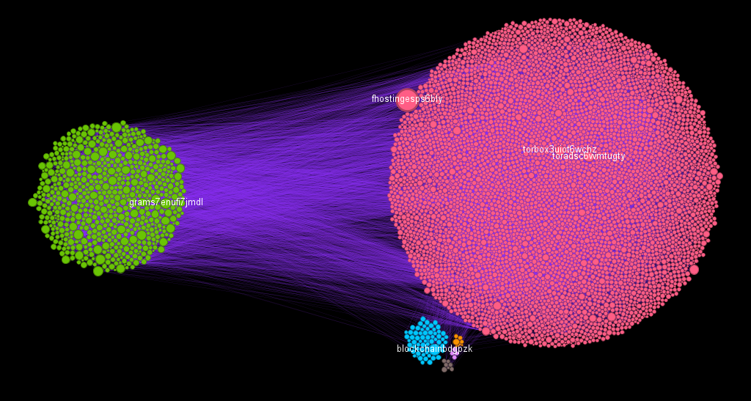
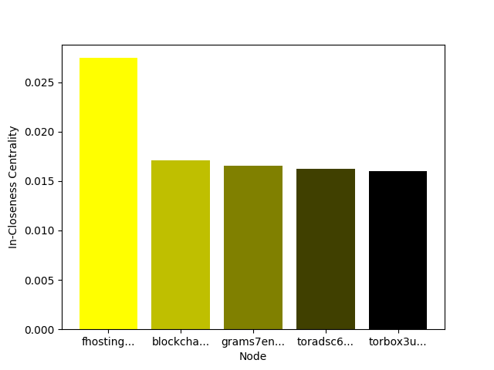
In-Closeness Centrality
Put Your Screenshot
Here
No nodes weights considered
Whole network considered
fhostingesps6bly (defunct): Formerly the largest Tor-specific web host, until the arrest of its owner in August 2013
blockchainbdgpzk: A popular bitcoin blockchain explorer service

Slide 24
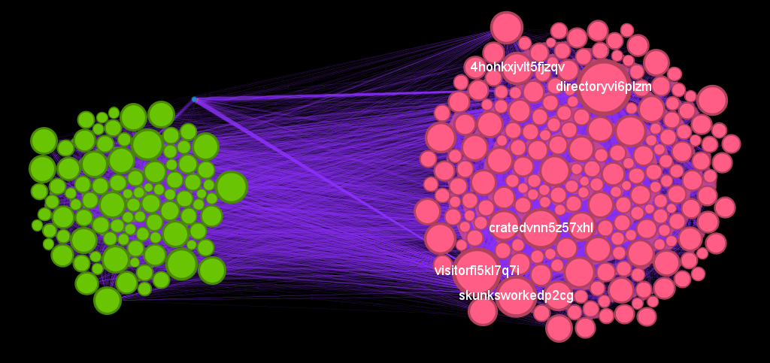
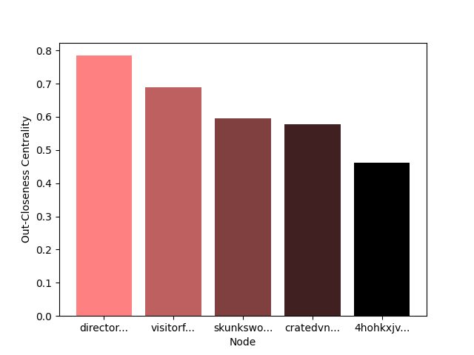
Out-Closeness Centrality
Put Your Screenshot
Here
No nodes weights considered
Whole network considered
directoryvi6plzm: Tor Directory: a list of onion
visitorfi5kl7q7i: VisiTOR Search Engine – Tor Hi

Slide 25
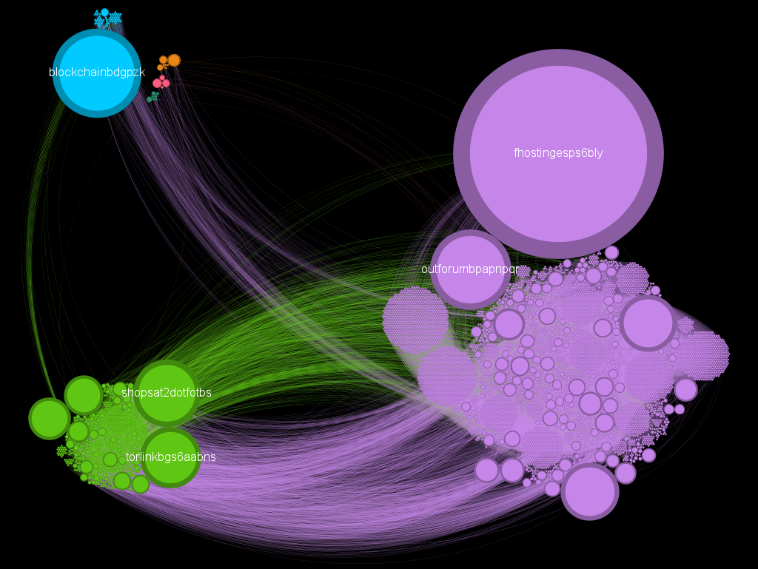
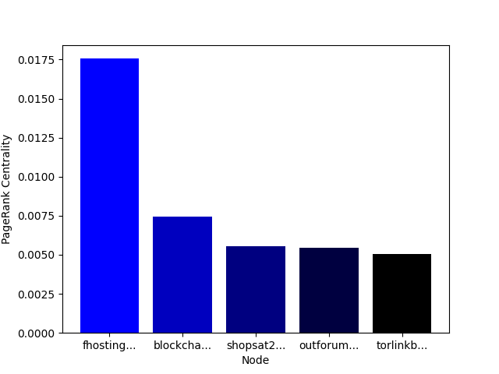
PageRank Centrality
Put Your Screenshot
Here
fhostingesps6bly (defunct): Formerly the largest Tor-specific web host, until the arrest of its owner in August 2013
blockchainbdgpzk: A popular bitcoin blockchain explorer service

Slide 26
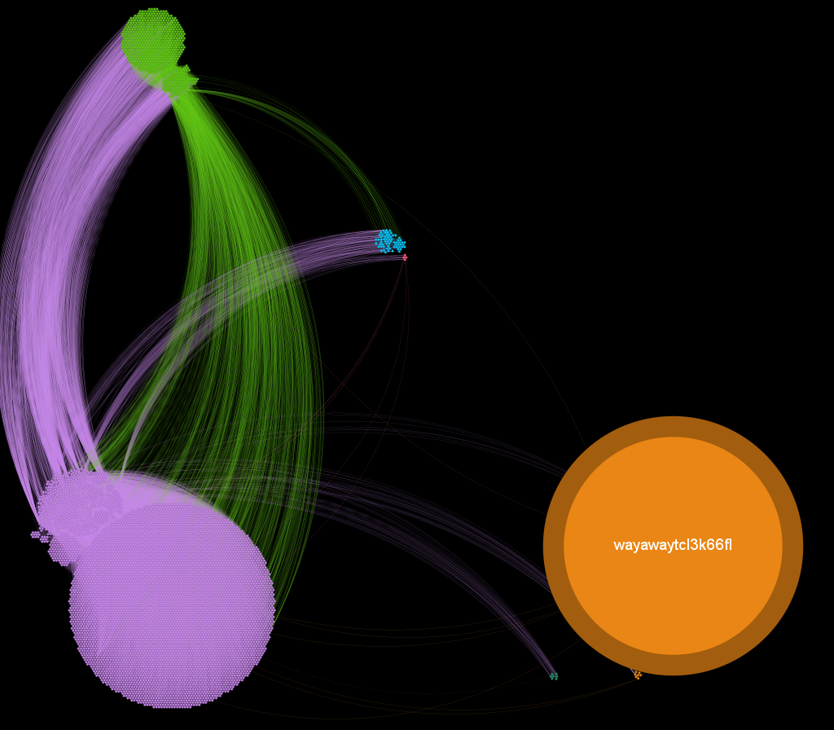
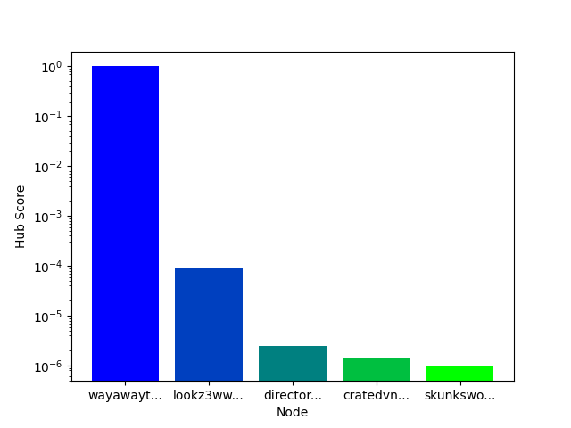
Hubs Score
Put Your Screenshot
Here
wayawaytcl3k66fl: Russian drug forum
lookz3wwyeucccba : Russian search engine

Slide 27
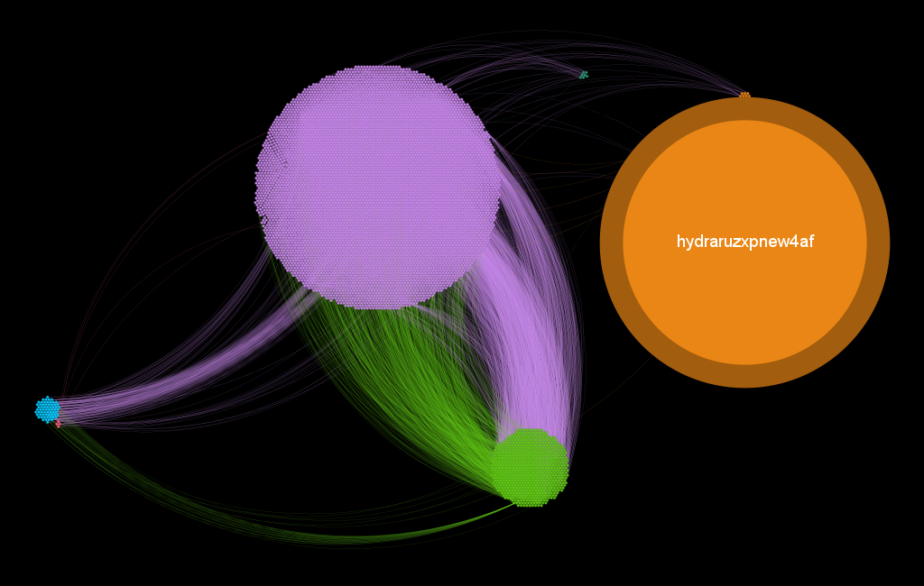
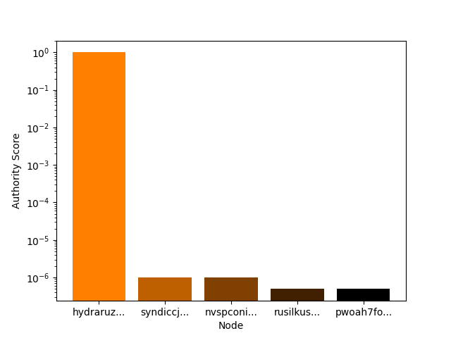
Authority Score
Put Your Screenshot
Here
hydraruzxpnew4af: Darknet drug marketplace
syndiccjacyrnbyv: Marketplace drugs

Slide 28
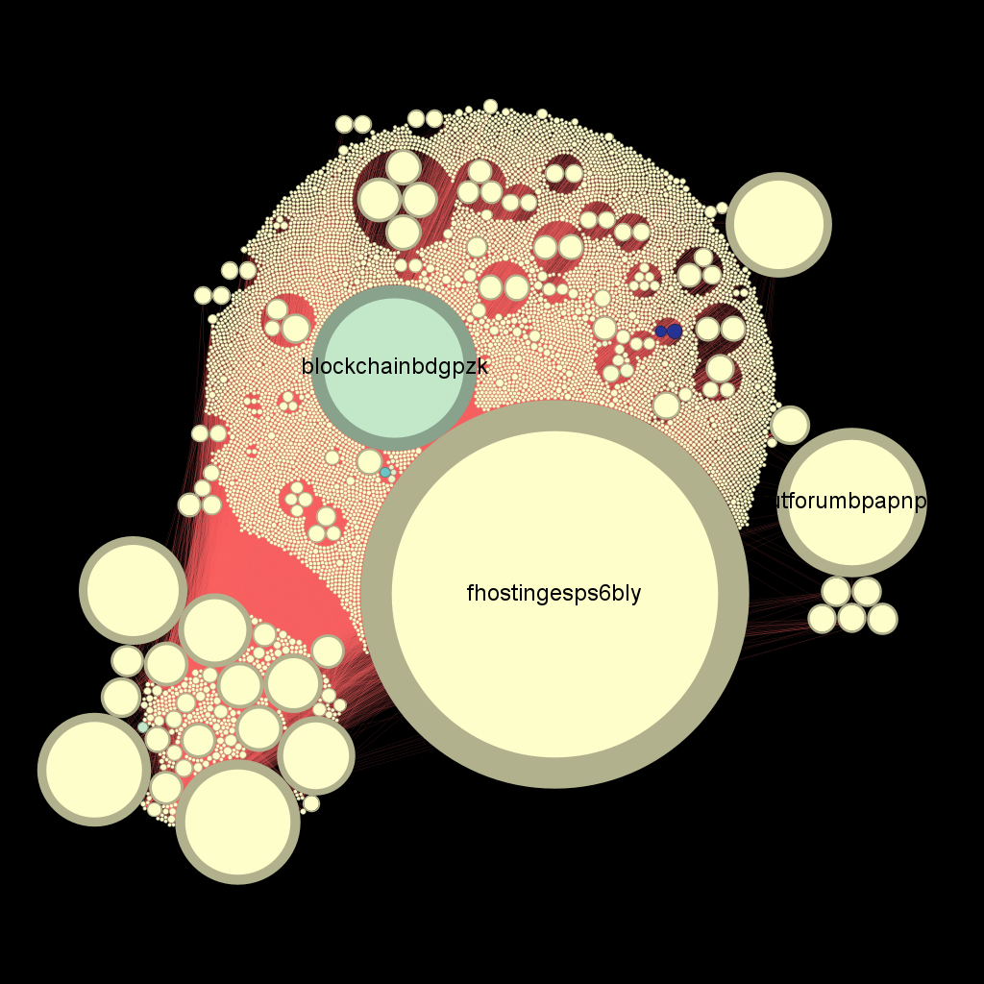
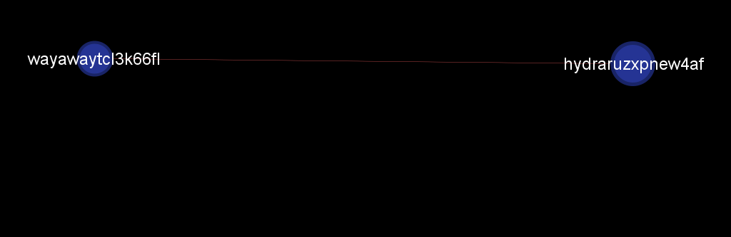
Analyze anomalies…
Out-Strength vs PageRank
Out-Strength ordered by color
PageRank ordered by dimension

Slide 29
03
MESOSCALE NETWORK ANALYSIS

Slide 30
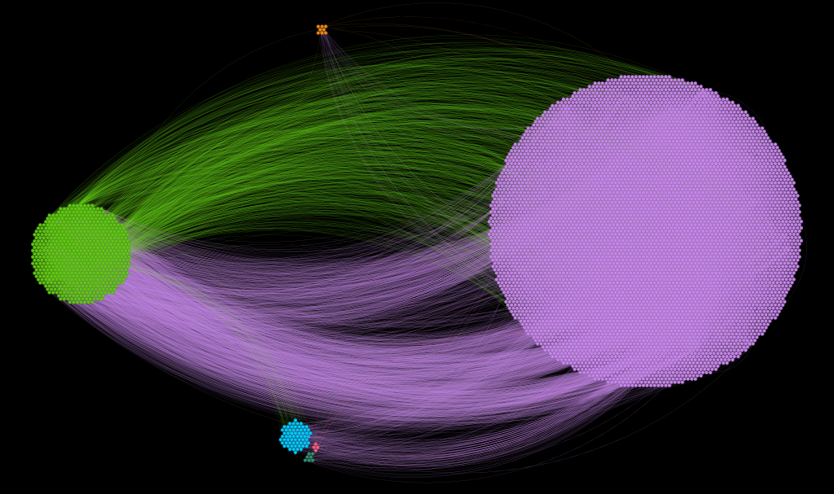
Community analysis - 1
Louvain Algorithm
Whole network considered
6 communities on average
Q = 0.582

Slide 31
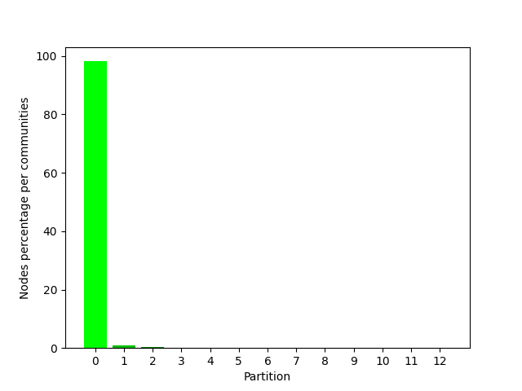
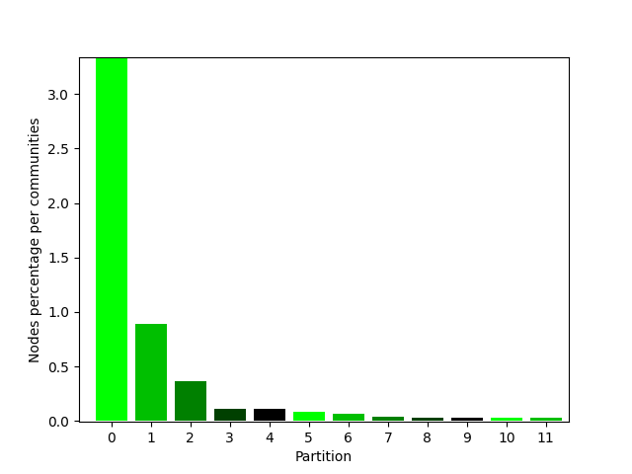
Community analysis - 2
Greedy Algorithm
Whole network considered
12 communities on average
Q = 0.618

Slide 32
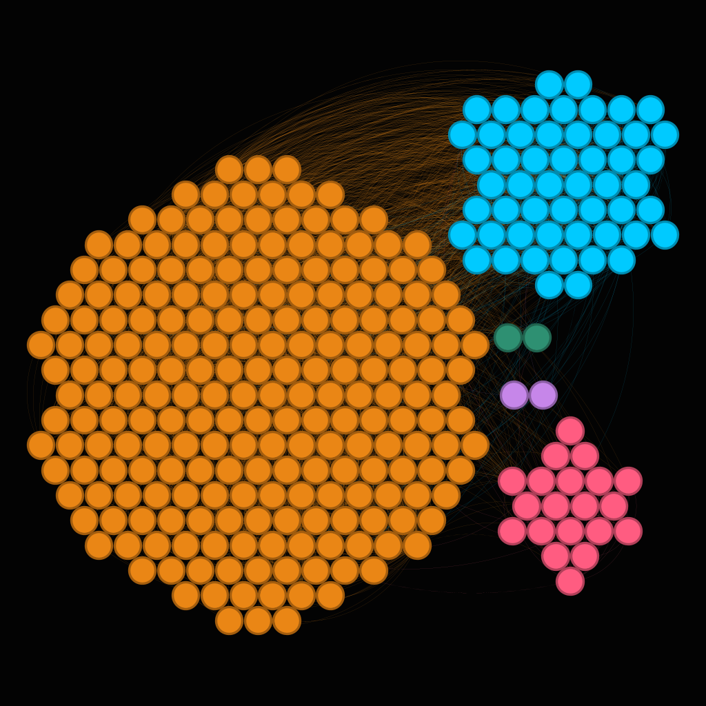
𝛼-Communities & 𝛼-Partitions - 1
Only SCC considered
Composed by 297 nodes
Directed and weighted
Louvain algorithm
5 communities on average
Q = 0.277

Slide 33
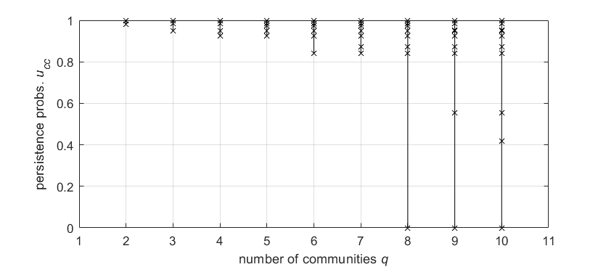
𝛼-Communities & 𝛼-Partitions - 2
Quality level 𝛼 = 0.8
Instead of Louvain we identify q = 7 community

Slide 34
𝛼-Communities & 𝛼-Partitions - 3
U₁₁ | U₂₂ | U₃₃ | U₄₄ | U₅₅ | U₆₆ | U₇₇
0.99 | 0.98 | --- | --- | --- | --- | ---
0.98 | 0.94 | 0.99 | --- | --- | --- | ---
0.92 | 0.99 | 0.98 | 0.94 | --- | --- | ---
0.99 | 0.97 | 0.92 | 0.98 | 0.94 | --- | ---
0.84 | 0.97 | 0.99 | 0.92 | 0.98 | 0.94 | ---
0.87 | 0.99 | 0.84 | 0.97 | 0.92 | 0.98 | 0.94
VALUE
RARE
IMITABLE
ORGANIZE
q =2
q = 3
q = 4
q = 5
q = 6
q = 7
Q = 0.30

Slide 35
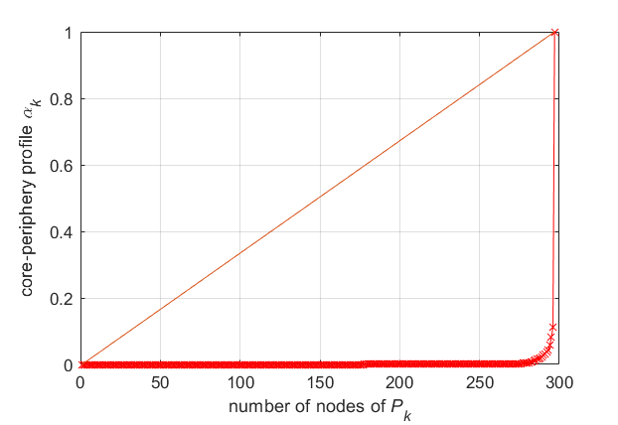
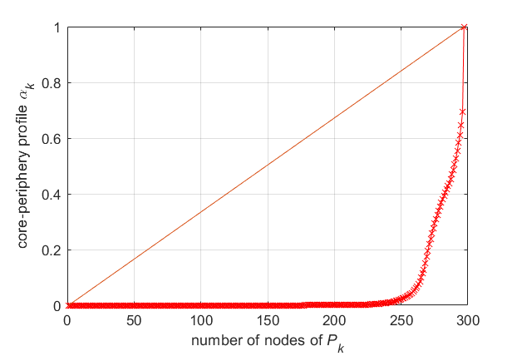
Core-Periphery profile - 1
Only SCC considered
Network directed
Weighted network considered
Star-like with weights
Unweighted network considered
Less star-like without weights

Slide 36
Core-Periphery profile - 2
CPS = 1: valhallaxmn3fydu (Valhalla Market)
CPS = 0.11 torlinkbgs6aabns (TorLinks — .onion Link List)
CPS = 0.08 lchudifyeqm4ldjj (Dream Market - Dark web market)
CPS = 1: shopsat2dotfotbs (Tor Shops)
CPS = 0.69: lchudifyeqm4ldjj
CPS = 0.64: tt3j2x4k5ycaa5zt (Blog)

Slide 37
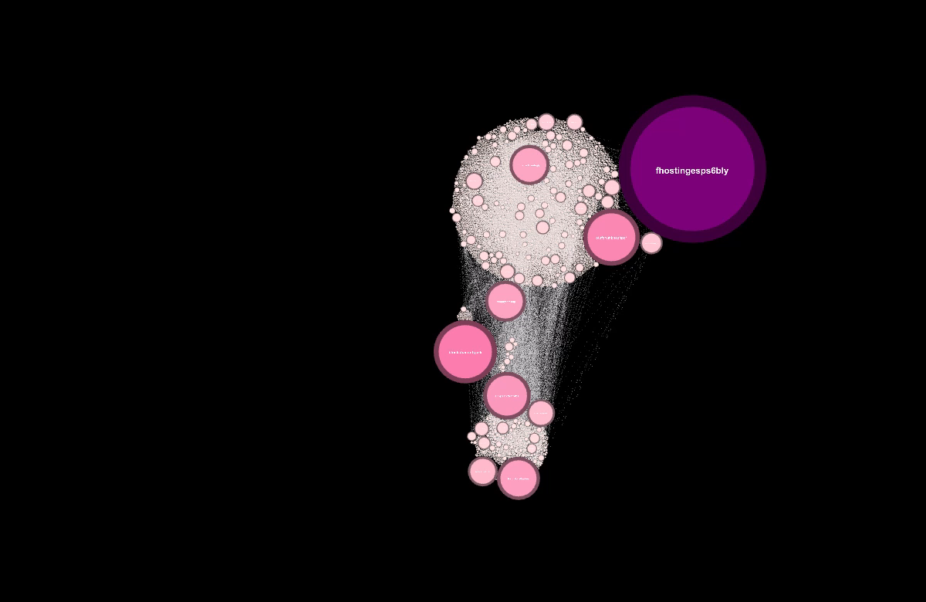
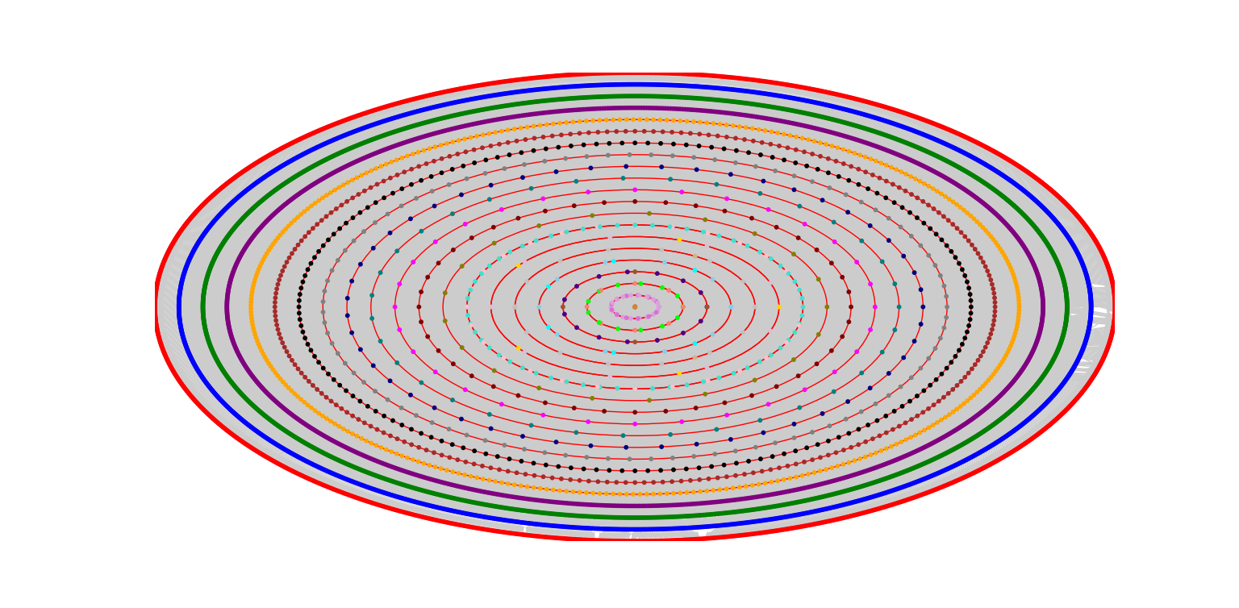
K-core decomposition
The whole network reaches k = 28

Slide 38
04
ROBUSTNESS & LINK PREDICTION

Slide 39
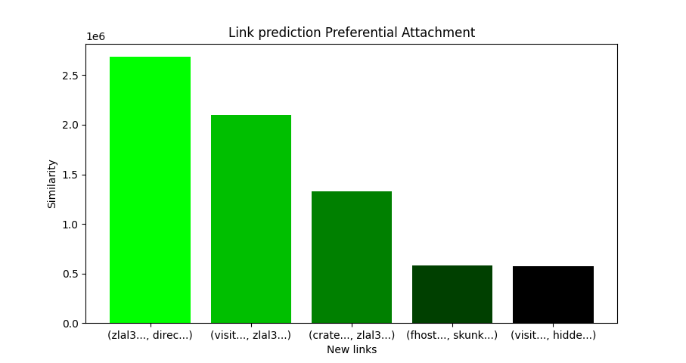
Link prediction – Preferential Attachment
Conversion from directed to undirected network
Whole network considered
directoryvi6plzm: Tor Directory: a list of onion
zlal32teyptf4tvi: Fresh Onions TOR Hidden Service Crawler
visitorfi5kl7q7i: VisiTOR Search Engine – Tor Hi

Slide 40
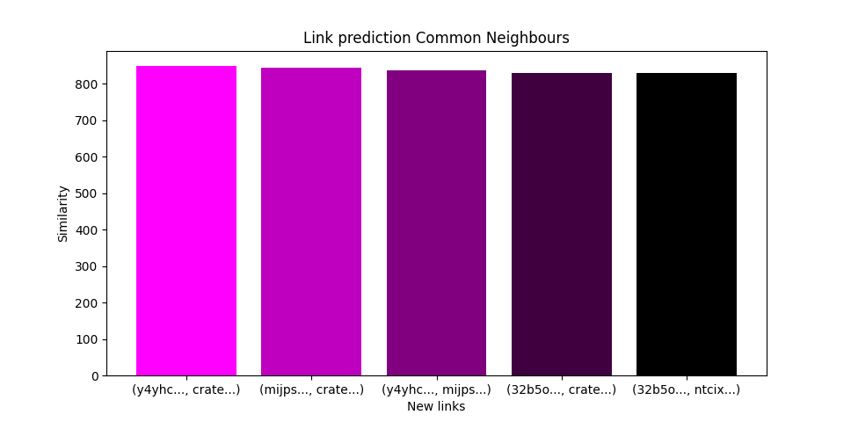
Link prediction – Common Neighbours
Conversion from directed to undirected network
Whole network considered
y4yhci7273s2yeqk: Tor Directory: a list of onion
cratedvnn5z57xhl:The onion crate REBOOT - Tor h
mijpsrtgf54l7um6: HiddenWiki link updated

Slide 41
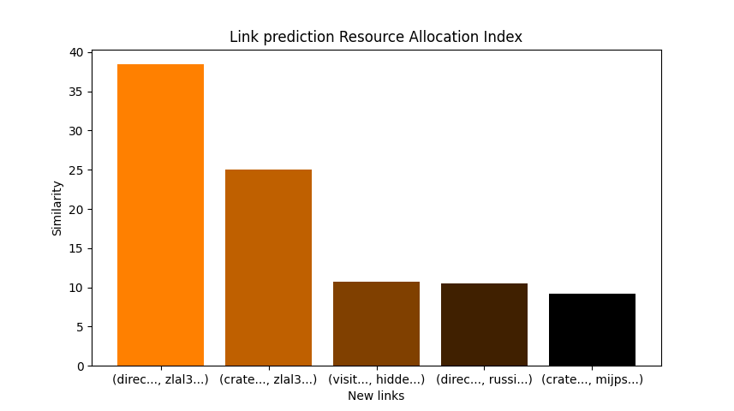
Link prediction – Resource Allocation Index
Conversion from directed to undirected network
Whole network considered
directoryvi6plzm: Tor Directory: a list of onion
zlal32teyptf4tvi: Fresh Onions TOR Hidden Service Crawler
cratedvnn5z57xhl:The onion crate REBOOT - Tor h

Slide 42
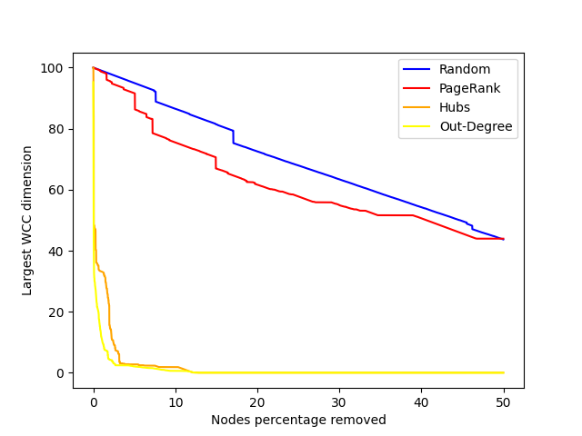
Robustness - 1
Whole network considered
Size of the largest connected component

Slide 43

Robustness - 2
Whole network considered
Value of efficiency

Slide 44
05
Deeper Analysis

Slide 45

Darkweb VS World-Wide-Web - 1
Only Out and SCC
Network with extraordinarily low out-degrees

Slide 46



Darkweb VS World-Wide-Web - 2
WWW network
SPL = 4.27
Whole Darkweb network
SPL = 4.35
SCC darkweb network
SPL = 3.97
Proof that Darkweb of how sparse darkweb is
SCC SPL is only 9% less than the entire darkweb
SCC no densely interconnected

Slide 47



Used technologies
Numerical analysis
Graphical analysis
Persistance probabilities
Core-Periphery Analysis
Numerical analysis
Various algorithms

Slide 48
THANKS FOR YOUR ATTENTION!
Tombini Nicolò - 10912627

